Slide 1
The Battle of Neighborhoods
Applied Data Science Capstone Project
By Akshay Kumar S

Slide 2
Introduction
This project aims to mimic the expertise of a local property agency situated in any part of the world. Utilizing the ample number of tools available to a Data Scientist, we will be providing expert advice on property rent rates and locality descriptions for would-be clients and match them with their ideal apartment.
For the sake of simplicity, This project deals with neighborhoods in London, UK. However, the analytical techniques used here can be utilized to replicate the same project in any locality.
Our primary targets, when analyzing neighborhoods in London are the following:
Rent distribution across neighborhoods,
Details of venues in each neighborhood.

Slide 3
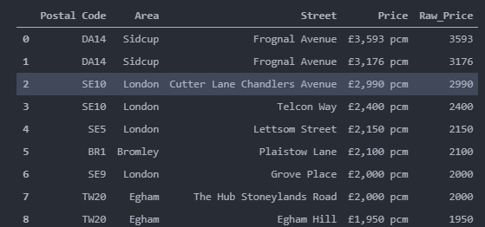
Data Requirements
The data on available apartments are collected by scraping a local website with apartment listings (https://www.your-move.co.uk).
We clean up the values and add a column for numerical data for Rent(ie.Price) The data is then processed to get our first dataframe:

Slide 4
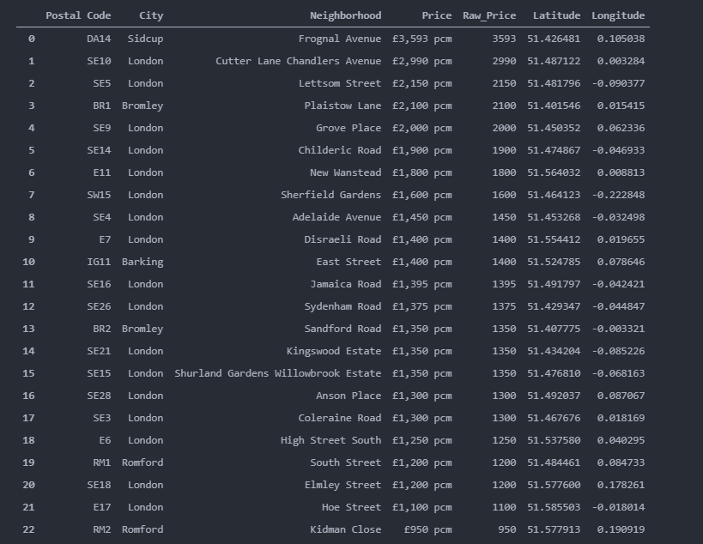
Data Requirements
It is further cleaned by removing Price values deviating from a monthly format and by removing duplicate values for Postal Code. The data contained information about places outside London as well, so a regex capture group was used to selectively extract Areas within London.
Next step was to obtain latitude and longitude for each Neighborhood in Dataset.All necessary information was readily available on doogal.co.uk.
The final data set which was used for analysis:

Slide 5
Methodology
Our process to achieve our targets in this project is as follows:
1.Identify neighborhoods on a leaflet map of London.
2.Collect data of all venues in each neighborhood
3.Segment the data into meaningful clusters
4.Conduct detailed cluster analysis
5.Conduct detailed Neighborhood analysis
6.Showcase the data using Folium,Bar and Bubble Charts
7.Formulate a conclusion using discovered relationship between location, rent and venue count within the neighborhood.

Slide 6
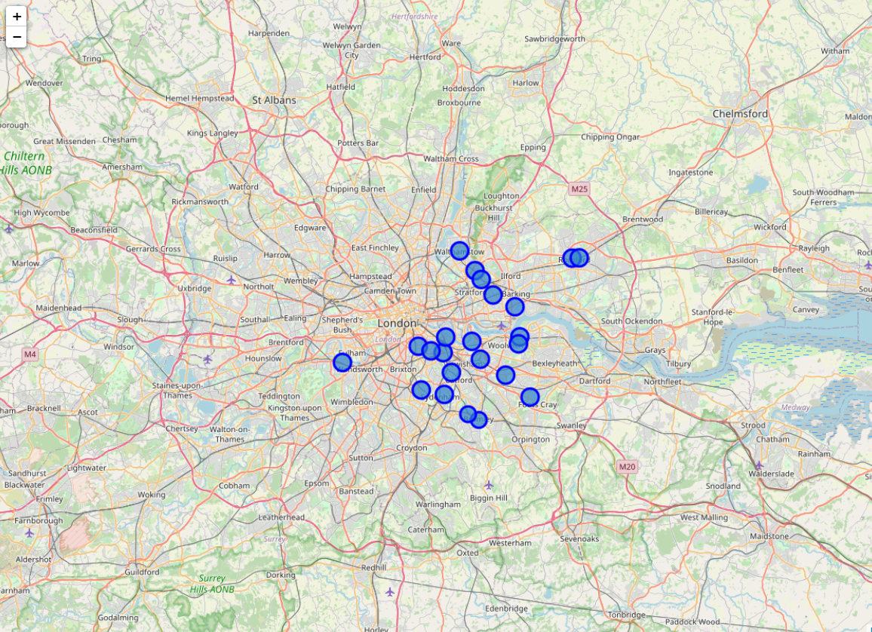
Analysis
As mentioned before, a data scientist has access to multiple tools to facilitate his analysis.
One such tool is Folium (Folium — Folium 0.12.1 documentation (python-visualization.github.io).
Folium let’s us plot the neighborhood locations on an interactive leaflet map.
The blue markers cover a 1km radius around our chosen neighborhoods. These regions cover the neighborhoods that pop up most frequently on their website.

Slide 7
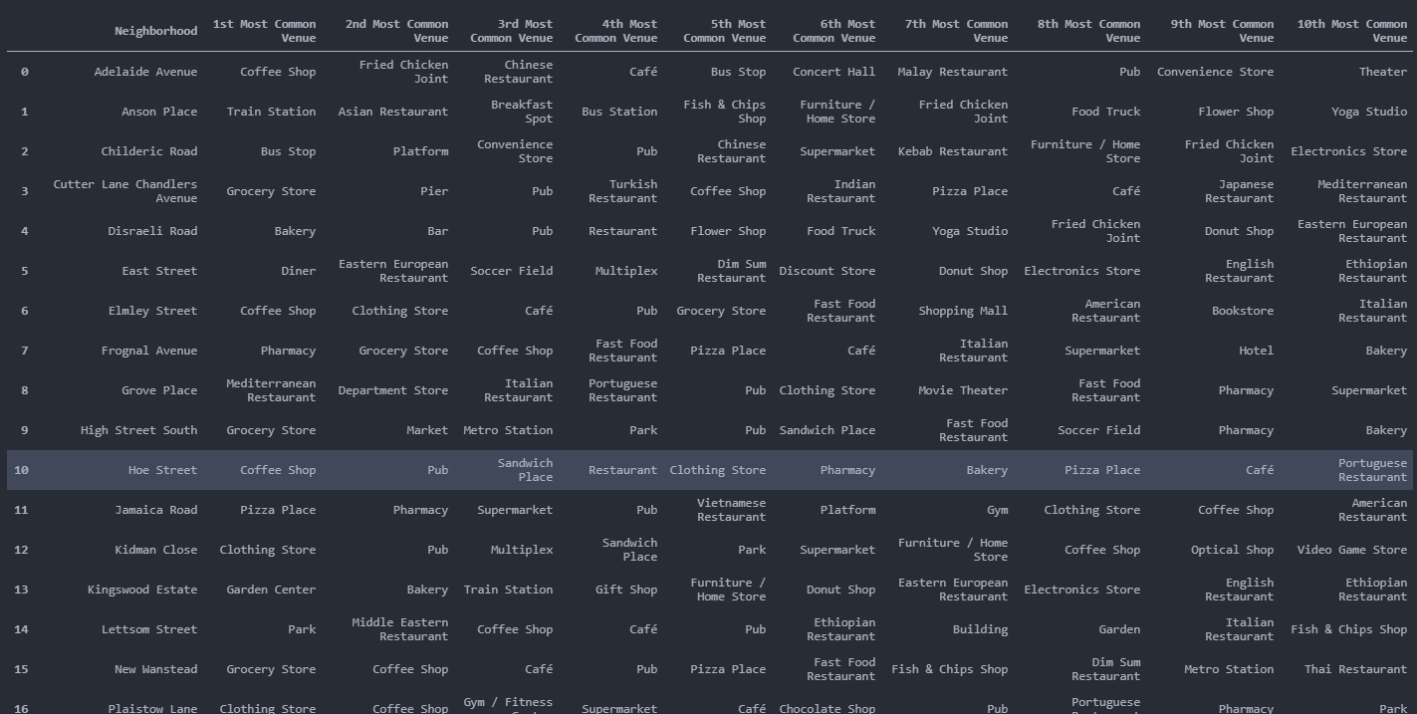
Analysis
The task of obtaining real world data of each and every venue located within each of the marked zones is made possible with the use of Foursquare API (www.Foursquare.com).
Foursquare API can be called with our credentials, by feeding it the latitude and longitude data of each neighborhood which we had collected beforehand. The API will return information pertaining to all the venues in that particular location in JSON format.
After cleaning, rearranging, grouping and classifying our data (All of which can be found in the Python Notebook for this project). We can find the Top 10 Venue Categories For Each Neighborhood based on their number of occurrences in each zone.

Slide 8
Analysis
We can see that not only is the table difficult to read, it is also not giving us much inferences to work with either.
One reason for that would be the localized nature of the values in the table. A work-around for such an issue would be to cluster the neighborhoods based on similarities. Since the data we have is unlabeled for such clustering operations we will utilize a machine learning technique knows as K-Means Clustering.

Slide 9
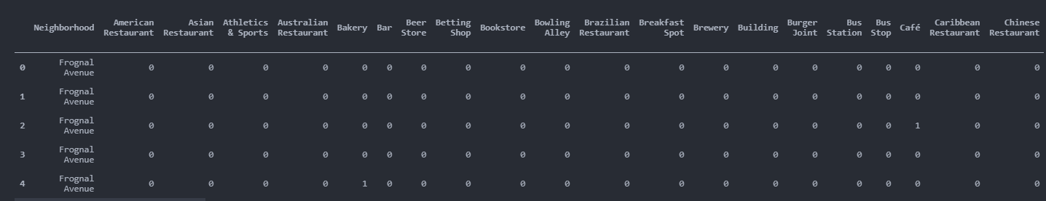
Analysis
Before we can conduct K-Means Clustering we have to perform some operations on our datasets.
The first requirement is to convert our categorical variables such as Venue Category into a machine readable format. This is done by using One-Hot Encoding.
One hot encoding transforms the DataFrame into one which provides unique identification for each categorical variable

Slide 10
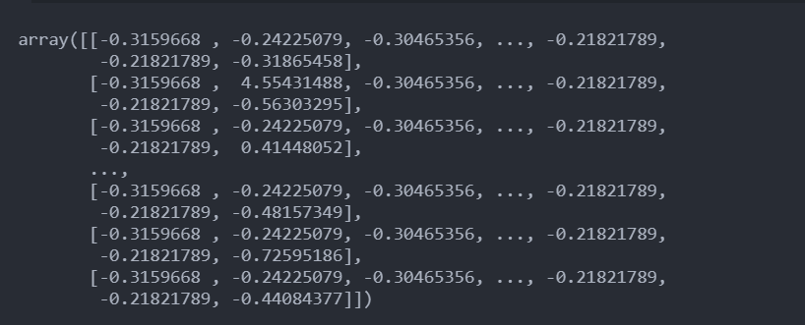
Analysis
The second requirement is to Standardize all numerical data. This is done so that large numerical values (Such as that from our Raw_Price variable) do not cause the algorithm to be skewed in their favor. This scaling is done using StandardScaler (sklearn.preprocessing.StandardScaler — scikit-learn 0.24.2 documentation).
Result of scaling our data is:

Slide 11
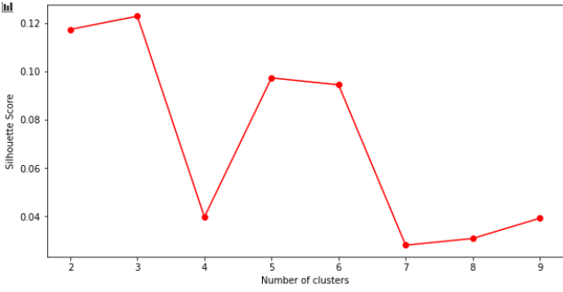
Analysis
K-Means is an unsupervised machine learning algorithm which can divide our data set into clusters based on data fed into it.However, before processing the data we have to figure out the ideal number of clusters for the given data set.
This can be done either through trial and error or by using the Silhouette Method, which calculates a silhouette score for each cluster.
Here although k=3 provides the highest score, we chose k=5 as three clusters would not provide us with enough data to make a decision.

Slide 12
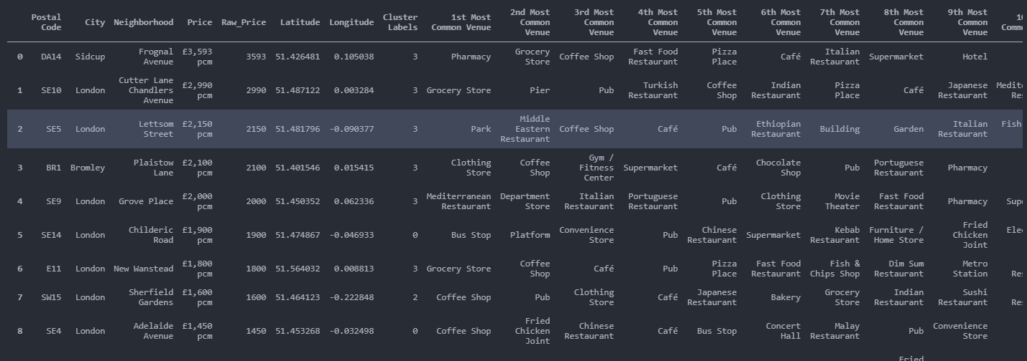
Analysis
Now keeping k ie.Number of Clusters as 6, we perform K-Means on our Dataset.
The Cluster Labels generated are added to our DataFrame

Slide 13
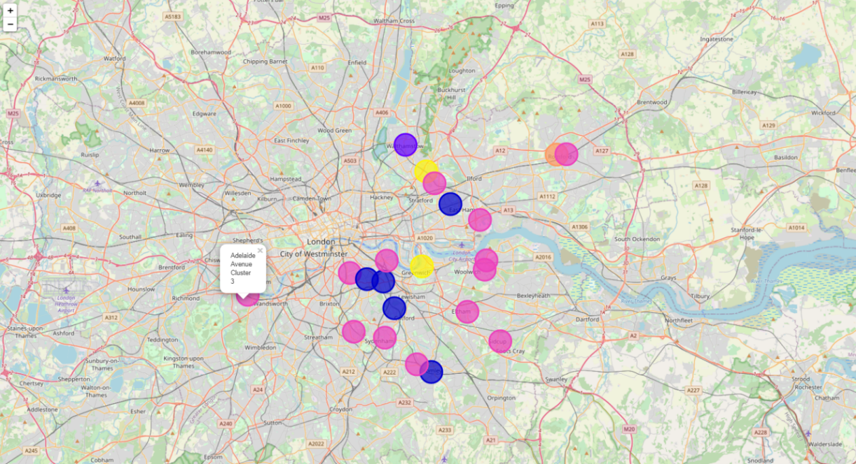
Analysis
Using this information we can plot another Folium map, but this time showcasing distribution of our Cluster Labels:
Yellow - Cluster 0
Blue - Cluster 1
Purple - Cluster 2
Pink -.Cluster 3
Orange - Cluster 4

Slide 14
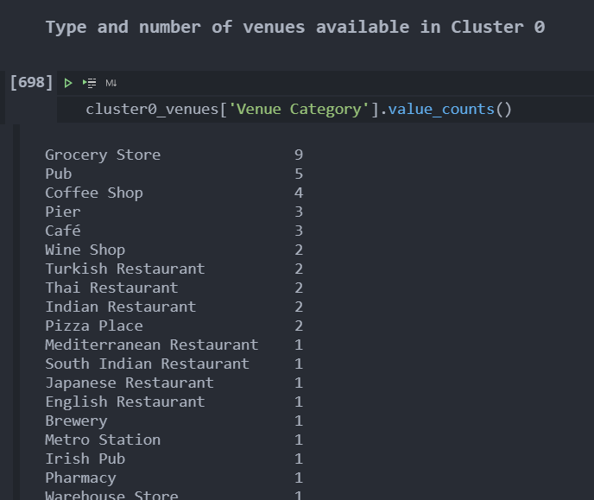
Analysis
Using the same concept we used before, We can run the Foursquare API to get our required venues, but this time separated based on Clusters.

Slide 15
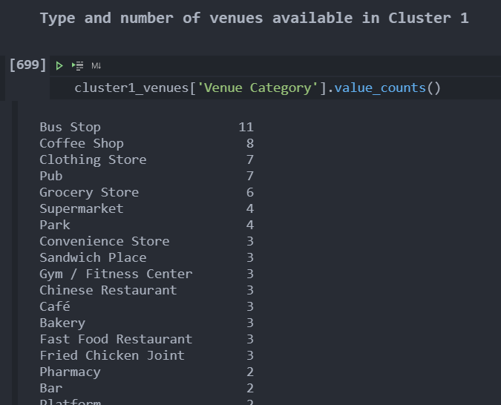
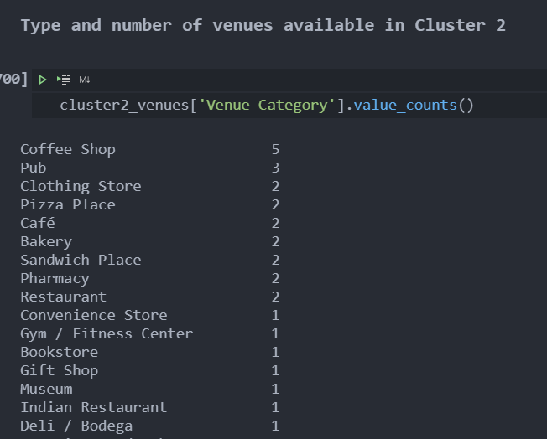
Analysis

Slide 16
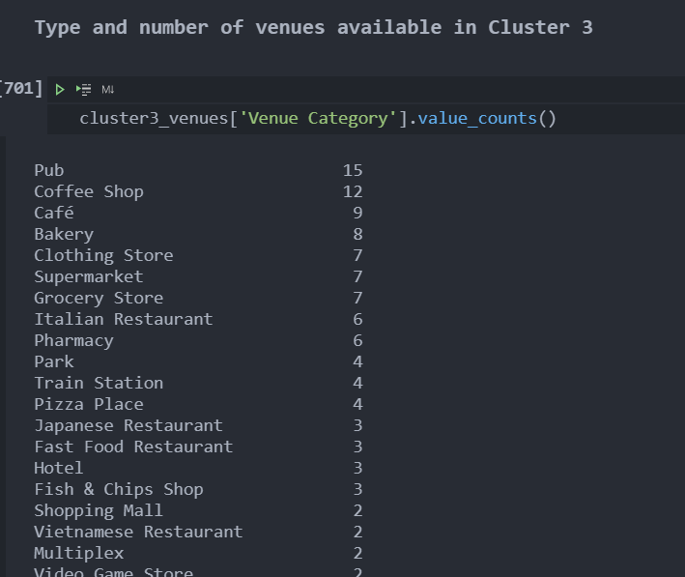
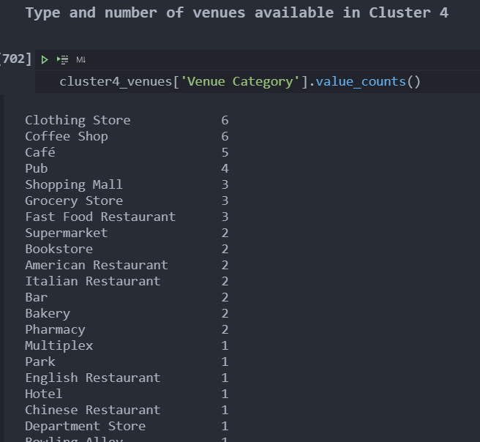
Analysis

Slide 17
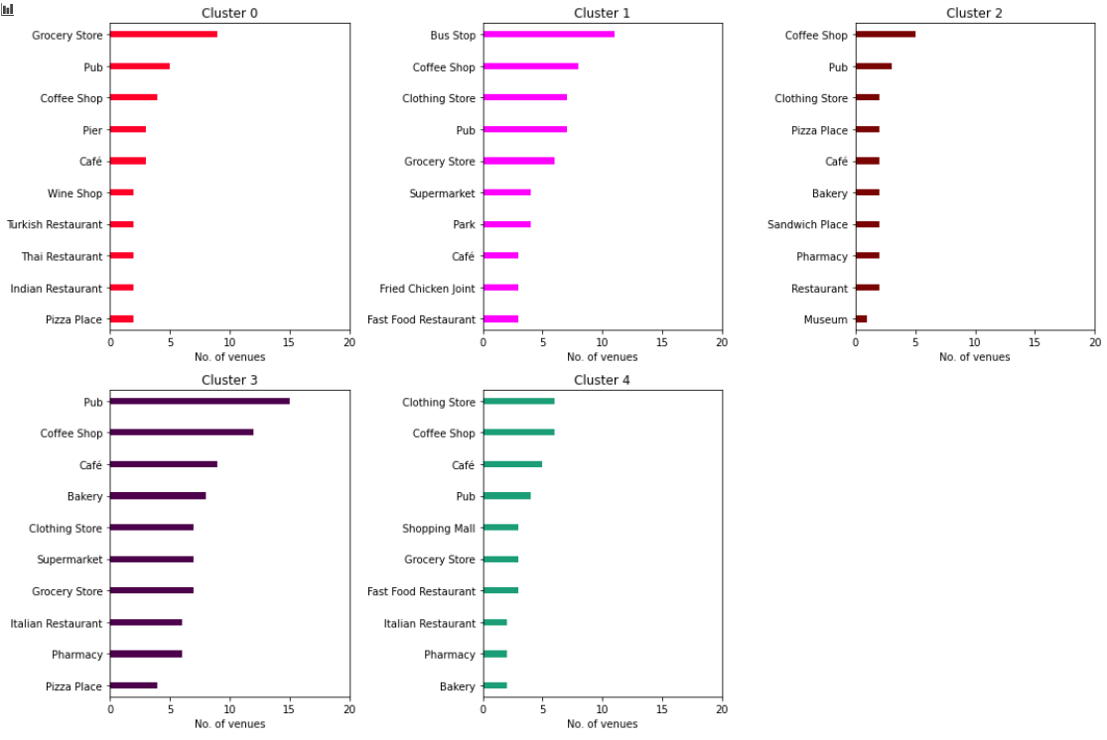
Analysis
We then plot this data as Bar Charts:
These graphs give us the top 10 Venue Type in each cluster and their total count within the clusters. This can give would-be clients a clear picture of what to expect when moving into these clusters.

Slide 18
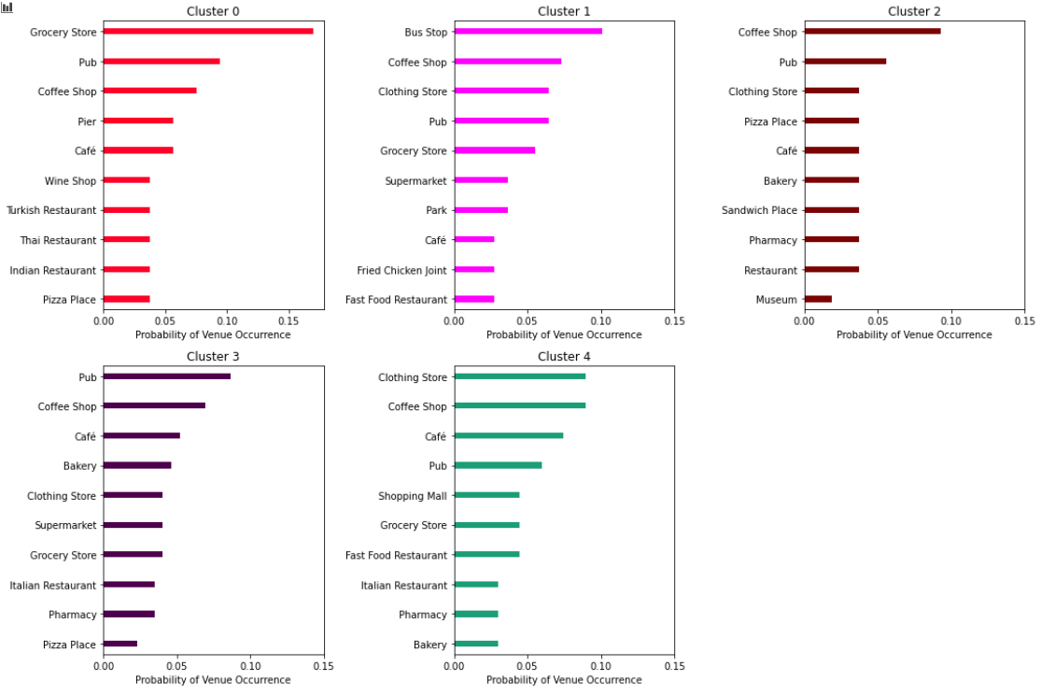
Analysis
However we can notice from our Folium Map that some of these clusters are very large and so if a would-be client had a issue of not availability but proximity of these venues, then we can provide them the probability of occurrence of these venues within 1km of any Apartment in these clusters as:

Slide 19
Analysis
Combining these two graphs, our client will be able to choose a neighborhood that has a high chance of fulfilling all of his personal requirements.
But we still have not answered another important question. The question of whether the client can afford the place.
Since we already have Rent Data for each of the neighborhoods in our Dataset. We can combine all the data which we have utilized thus far and present it in an easy to understand Bubble Chart

Slide 20
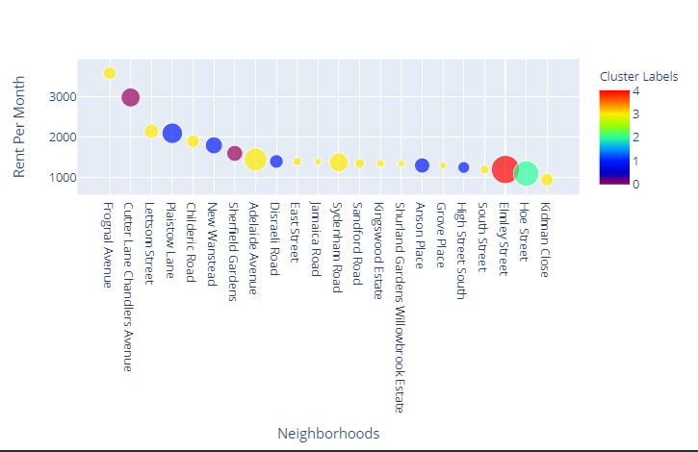
Analysis
In this Bubble Chart, Rent per month for each neighborhood is plotted against each other with size of the Bubble representing the number of venues in that neighborhood.
Here we can observe the relationship between these three factors and combining with data about venue details within each cluster, Our client can finally choose which location to relocate to based on his personal needs and their budget

Slide 21
Results
Case 1:
An international exchange student is moving to London. The student is trying to lessen her expenses as much as possible during her stay. This also means that close proximity to public travel is mandatory as the student will not have a vehicle. Which location should she be shown ?
Sol: Based on our data, Properties in Cluster 1 have high chances of being close to a Bus Stop. Disraeli Road, Anson Place and High Street South all fall in Cluster 1 and also has the lowest rent rates in the cluster.Therefore, the student can be shown properties in these three locations

Slide 22
Results
Case 2:
A Japanese Businessman is shifting his business to UK and wishes to stay in London. He has amassed a fortune and wants to be located in a very affluent location. Which place should he be shown ?
Sol: Here we can see that, based on our data and contrary to popular belief, Cluster 4 which has one of the lowest rent rates should be recommended to the person. This is because Cluster 4 has several high quality venues such as Shopping Malls, Italian Restaurants, Pubs, Clothing Stores etc.

Slide 23
Results
Case 3:
A London resident wishes to relocate to a better neighborhood. She currently stays near Sydenham Road and wants to shift to a place that’s more suited for raising her kids who have just started going to school. Which place should she see ?
Sol: We can see that our client currently resides in Cluster 3. From looking at our venue data for Clusters, we can see that if she shifted to an area in Cluster 1, her children will have close proximity to a park. However, the only place in cluster 1 that has access to larger number of venues than Sydenham Road is Plaistow Lane. We can show her the place and let her decide if the location is worth the increased rent she has to cover.

Slide 24
Discussion & Conclusion
From the example cases in the Results section, we can see that our model has been able to accurately mimic and in some cases even out-do the services of a local property agency. The same model can be reconfigured for locations around the world.
Businesses that offer property listings, for rent or purchase, can also consider adding such a modelling approach to their repertoire. Since most modern property listing websites give limited information regarding the neighborhood of their listing, any company that can incorporate such detailed neighborhood analysis can not only automate the process for all listings in their website but also gain a significant advantage over their competitors.

Slide 25
THANK YOU

